Slide 1
FUNDERMENTALS OF ALGORITHM
LECTURER TEKOR PALMER

Slide 2
ORDER STATISTICS
In computer science, a selection algorithm is an algorithm for finding the th smallest value in a collection of ordered values, such as numbers. The value that it finds is called the th order statistic. Selection includes as special cases the problems of finding the minimum, median, and maximum element in the collection.

Slide 3
Practical application of order statistics include
Let’s say you had three weights: X₁ = 22 kg, X₂ = 44 kg, and X₃ = 12 kg. To get the order statistics (Y_{n}), put the items in numerical increasing order:
Y₁ = 12 kg
Y₂ = 22 kg
Y₃ = 44 kg
The kth smallest X value is normally called the kth order statistic.
More formally,
If X₁, X₂,…, X_{n} are random iid observations taken from a population with n continuous observations, the random variables Y₁ < Y₂ < …, < Yn denote the sample’s order statistics.

Slide 4
String Matching Algorithm
String matching algorithms have greatly influenced computer science and play an essential role in various real-world problems. It helps in performing time-efficient tasks in multiple domains. These algorithms are useful in the case of searching a string within another string. String matching is also used in the Database schema, Network systems. Let us look at a few string matching algorithms before proceeding to their applications in real world. String Matching Algorithms can broadly be classified into two types of algorithms –

Slide 5
Types of String Matching Algorithm
Exact String Matching Algorithms:
Exact string matching algorithms is to find one, several, or all occurrences of a defined string (pattern) in a large string (text or sequences) such that each matching is perfect. All alphabets of patterns must be matched to corresponding matched subsequence. These are further classified into four categories

Slide 6
Algorithms based on character comparison
Naive Algorithm: It slides the pattern over text one by one and check for a match. If a match is found, then slides by 1 again to check for subsequent matches.
KMP (Knuth Morris Pratt) Algorithm: The idea is whenever a mismatch is detected, we already know some of the characters in the text of the next window. So, we take advantage of this information to avoid matching the characters that we know will anyway match.
Boyer Moore Algorithm: This algorithm uses best heuristics of Naive and KMP algorithm and starts matching from the last character of the pattern.
Using the Trie data structure: It is used as an efficient information retrieval data structure. It stores the keys in form of a balanced BST.

Slide 7
Automaton Matcher Algorithm: It starts from the first state of the automata and the first character of the text. At every step, it considers next character of text, and look for the next state in the built finite automata and move to a new state.
Algorithms based on Bit (parallelism method):
Aho-Corasick Algorithm: It finds all words in O(n + m + z) time where n is the length of text and m be the total number characters in all words and z is total number of occurrences of words in text. This algorithm forms the basis of the original Unix command fgrep.
Hashing-string matching algorithms:
Rabin Karp Algorithm: It matches the hash value of the pattern with the hash value of current substring of text, and if the hash values match then only it starts matching individual characters.

Slide 8
Approximate String Matching Algorithms:
Approximate String Matching Algorithms (also known as Fuzzy String Searching) searches for substrings of the input string. More specifically, the approximate string matching approach is stated as follows: Suppose that we are given two strings, text T[1…n] and pattern P[1…m]. The task is to find all the occurrences of patterns in the text whose edit distance to the pattern is at most k. Some well known edit distances are – Levenshtein edit distance and Hamming edit distance.
These techniques are used when the quality of the text is low, there are spelling errors in the pattern or text, finding DNA subsequences after mutation, heterogeneous databases, etc. Some approximate string matching algorithms are:
Naive Approach: It slides the pattern over text one by one and check for approximate matches. If they are found, then slides by 1 again to check for subsequent approximate matches.
Sellers Algorithm (Dynamic Programming)
Shift or Algorithm (Bitmap Algorithm)

Slide 9
Applications of String Matching Algorithms:
Plagiarism Detection: The documents to be compared are decomposed into string tokens and compared using string matching algorithms. Thus, these algorithms are used to detect similarities between them and declare if the work is plagiarized or original

Slide 10
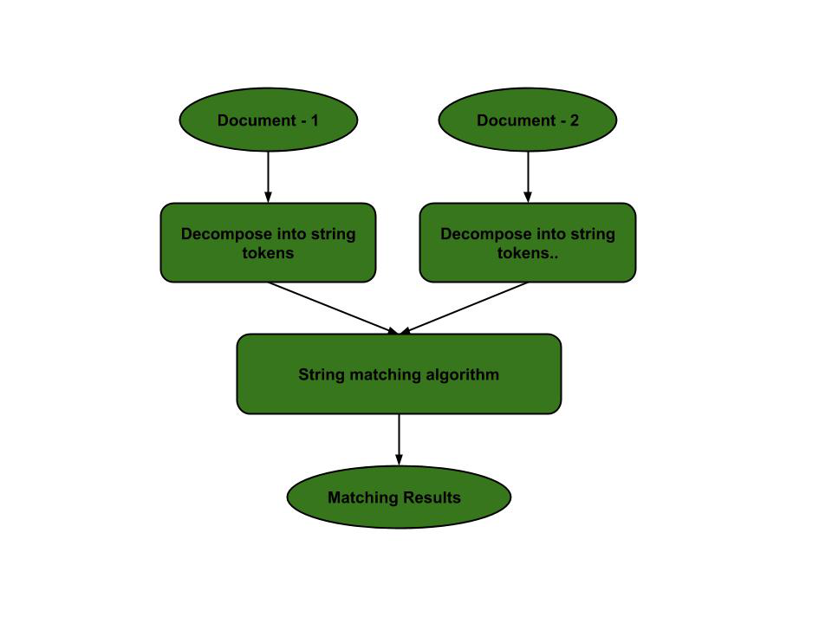

Slide 11
Bioinformatics and DNA Sequencing: Bioinformatics involves applying information technology and computer science to problems involving genetic sequences to find DNA patterns. String matching algorithms and DNA analysis are both collectively used for finding the occurrence of the pattern set.

Slide 12
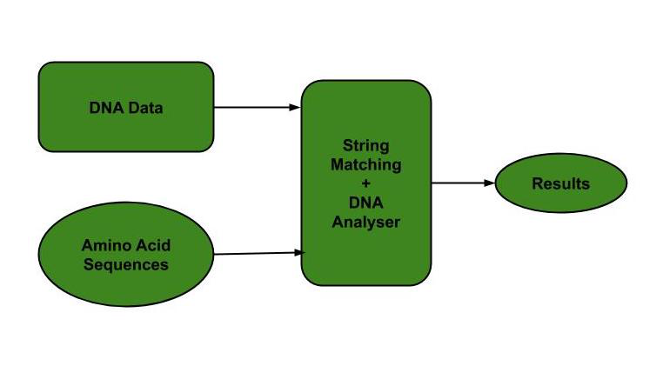

Slide 13
Search engines or content search in large databases: To categorize and organize data efficiently, string matching algorithms are used. Categorization is done based on the search keywords. Thus, string matching algorithms make it easier for one to find the information they are searching for.

Slide 14
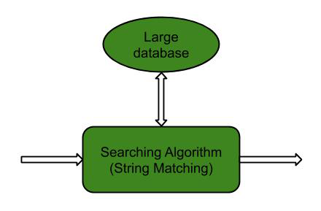

Slide 15
Implementation of C programming
C programming language is one of the most popular programming language. It is a must learn for software engineering students. C is called the mother of all modern programming languages so learning C will help you to learn other languages easily like Java, C++, C#, Python, etc. C language is faster than other

Slide 16
What is C?
C is a general-purpose, procedural, high-level programming language used in the development of computer software and applications, system
C programming language is known for its simplicity and efficiency. It is the best choice to start with programming as it gives you a foundational understanding of programmingprogramming, games, web development, and more

Slide 17
Applications of C Language
C was used in programs that were used in making operating systems. C was known as a system development language because the code written in C runs as fast as the code written in assembly language.
The use of C is given below:
Operating Systems
Language Compilers
Assemblers
Text Editors
Print Spoolers
Network Drivers
Modern Programs
Databases
Language Interpreters
Utilities

Slide 18
Characteristics of C
C is an old language, but it still remains popular to this day, even after all these years.
It owes its popularity to the rise and success of Unix, but nowadays it has gone far beyond just being the 'native' language of Unix. It now powers most, if not all, of the world's servers and systems.
C is fast and efficient
C is powerful and flexible
C is portable, performant, and machine-independent
C inspired the creation of many other programming languages E.g Python, Ruby, PHP and Java, were inspired by C

Slide 19
C Compilation Process: Write-Compile-Run
What is a program in C?
A computer program written in C is a human readable and ordered set of instructions that a computer executes. It aims to provide a solution to a specific computing problem and tell the computer to perform a certain task with a sequence of instructions that it needs to follow
A program has keywords, which are specific words that are reserved and are part of the language. It also has literal pieces of data like strings and numbers. And it has words that follow the language’s rules, which we define and introduce to the language that don’t already exist (like variables or methods).

Slide 20
What is a compiler?
When we write programs in human readable form, we can understand them – but the computer may not be able to. Computers don’t directly understand programming languages, they only understand binary. So programs need to be translated into this other form so the computer can actually understand our program's instructions.
Programs in high level languages can be either compiled or interpreted. They use special pieces of software called compilers and interpreters, respectively

Slide 21
How to write C source code
In order to develop C programs, we first need to have some type of text editor. A text editor is a program we can use to write our code (called our source code) in a text file.
You can also use an IDE (Integrated Development Environment), or text editor with IDE-like features (an integrated terminal, the ability to write, debug, run and execute our programs all in one place without leaving the editor, and much more).
One editor with these capabilities is Visual Studio Code, using the C/C++ extension. Throughout the rest of this tutorial we'll use VSCode

Slide 22
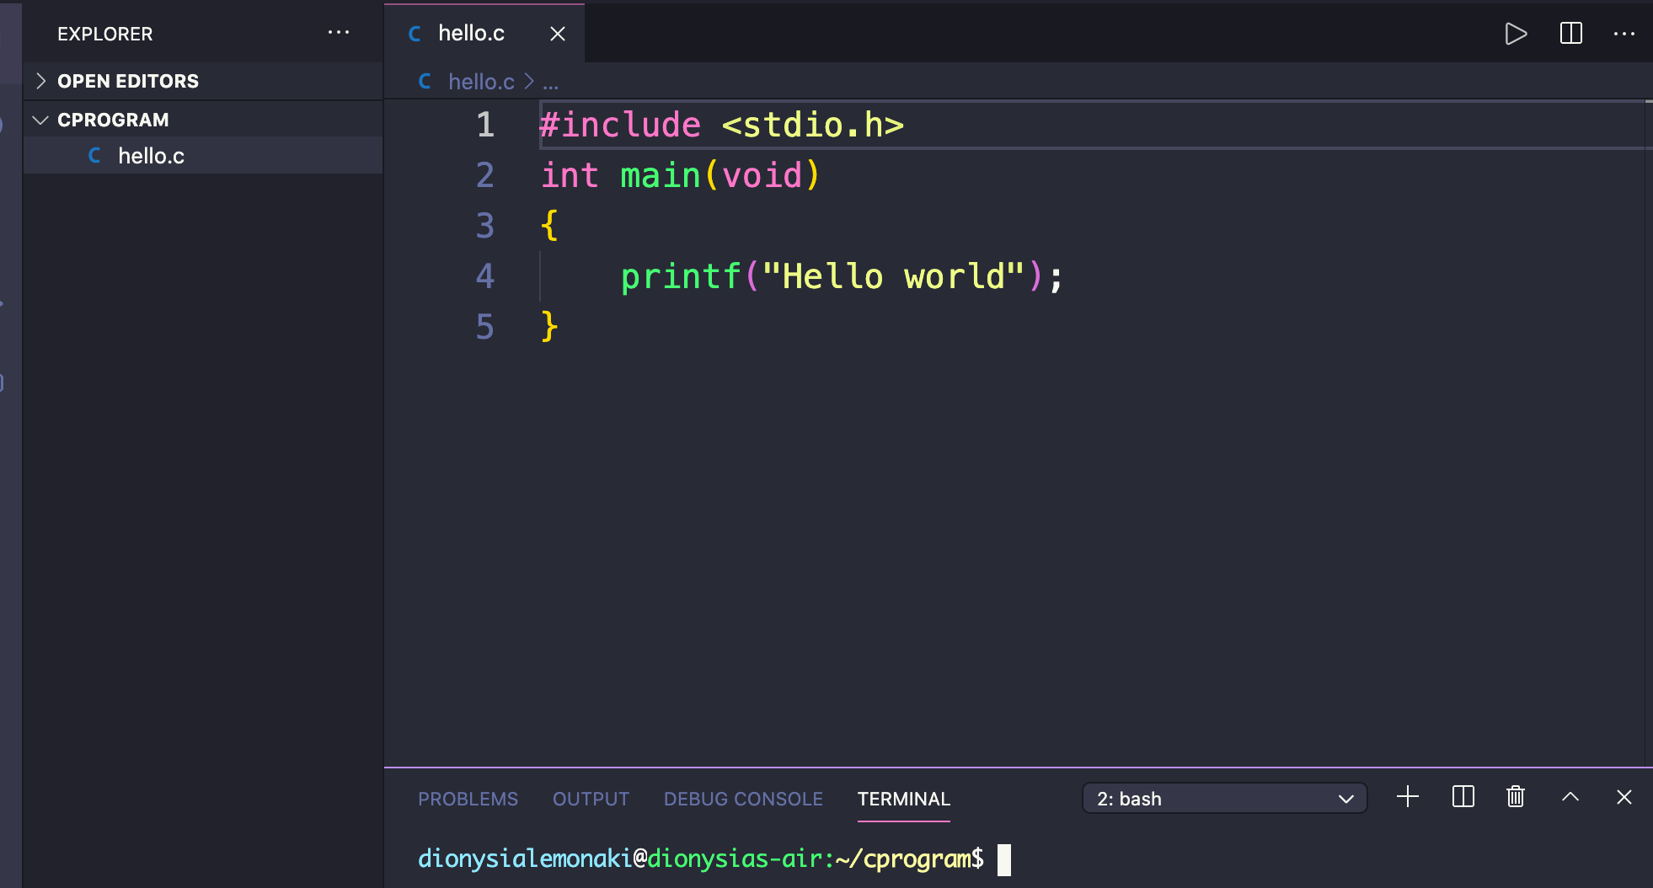
An Example of a C code

Slide 23
Real-World Applications of C
Operating Systems:
Scripting of UNIX operating system was the primary purpose behind creation of C. Additionally, as programs scripted in C get executed with speeds equivalent to assembly language, C language has been an integral part of the development of multiple operating systems. Unix-Kernel, Microsoft Windows utilities and operating system applications, and a large segment of the Android operating system have all been scripted in C.

Slide 24
Development of New Languages:
Efficiency of code execution and simplicity have resulted in C directly or indirectly influencing development of many languages including C++ which is C with classes, C#, D, Java, Limbo, JavaScript, Perl, UNIX’s C Shell, PHP and Python, and Verilog. These languages use C in variable capacity: for instance, in Python, C is used for building standard libraries, while others like C++, Perl and PHP have syntax and control structures based upon C.

Slide 25
Computation Platforms:
C implements algorithms and data structures swiftly, facilitating faster computations in programs. This has enabled the use of C in applications requiring higher degrees of calculations like MATLAB and Mathematica
Embedded Systems:
Various features of C including direct access to machine level hardware APIs, presence of C compilers, deterministic resource use and dynamic memory allocation make C language an optimum choice for scripting applications and drivers of embedded systems.

Slide 26
Graphics and Games:
C language has been used in the development of a variety of graphics and gaming applications, such as chess, bouncing ball, archery etc.

